Slide 1
Online-banking
GROUP NO – 5
TEAM LEAD – NIRMAL KUMAR R

Slide 2
Real Life Lab(Rll)- Team Project Online Banking
Group Members:-
1.Partha Pratim Das
2.Nehal Ahmad
3.Mohammed Ismail A Khazi
4.Nune Raju
5.Marella Harika
6.Panditi Lakshmi Ruchitha
7.Pathuri Om Sreeja
8.Medapati Sivani
9.Manikandan Mariyappan

Slide 3
Problem Statement
The business analysts noticed a drop in the number of customers of the bank. They find out that online banking systems are making profits by eliminating the middle men. In order to eliminate the middle men we have to built a online application with a rich and user friendly interface. In this application user can perform all the operations with out involving another person.

Slide 4
Abstract
It is for an online comprehensive solution to manage Online Banking .This is accessible to all customers who have a valid user id and passwords . In todays world a number of banks have either gone for online banking or are on verge of going for it. Online Banking enables the customers to transact business on line in real time.
Online banking system provides the facilities like Balance enquiry , Funds transfer , Loan enquires , Request for cheque book/change of address/viewing monthly and annual statements . Online banking system has developed a new security infrastructure for commerce on the internet . The initiative, called ICIN Bank aims to provide a secure infrastructure for customers.

Slide 5
Project Objective: Create a dynamic and responsive Java online banking web application to deposit ,withdraw , and transfer money between accounts.
Proposed System: In this system, Customer will have a unique login id and password. By using this id and password only user can enter into account and he can create a new account and perform operations. Admin will also have a unique id and password through which he can enter into application. He can block a account or he can accept, decline the transaction, loan request, cheque book request.

Slide 6
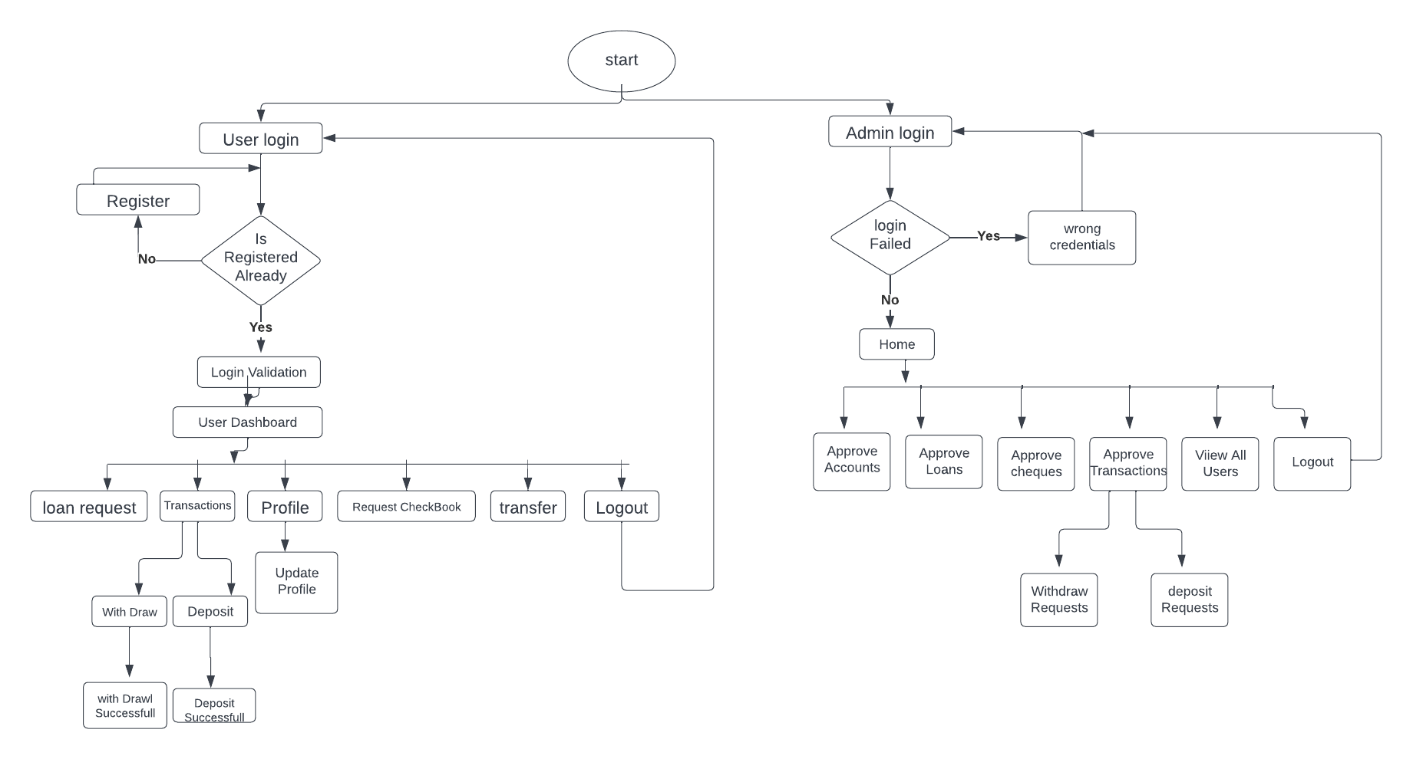
OVERALL FLOW CHART

Slide 7
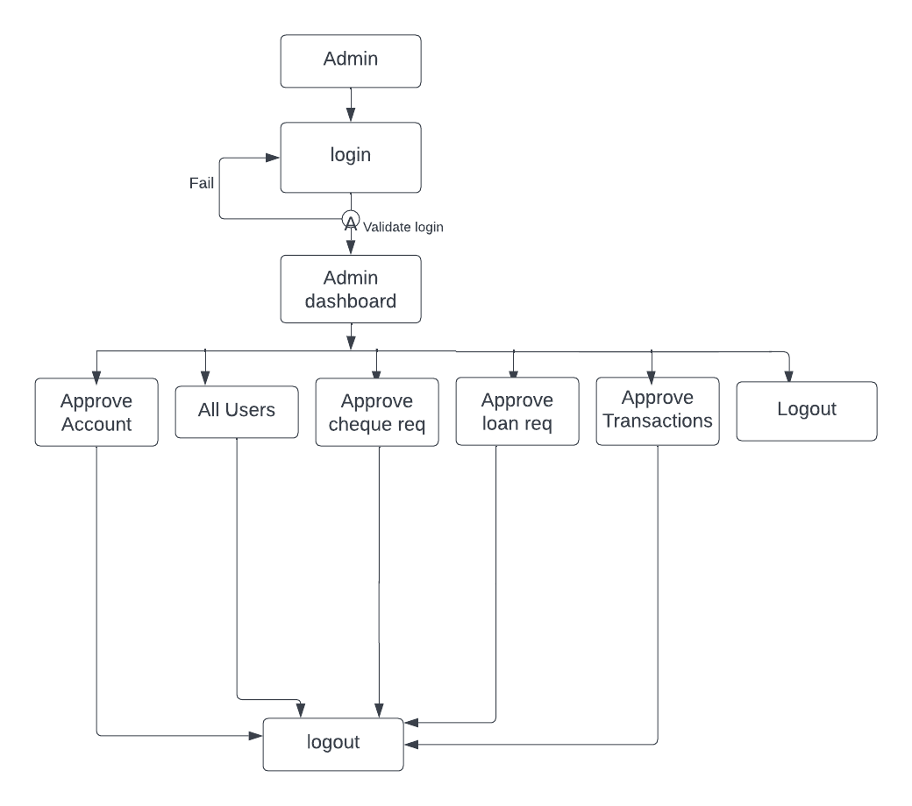
Admin Activity Diagram

Slide 8
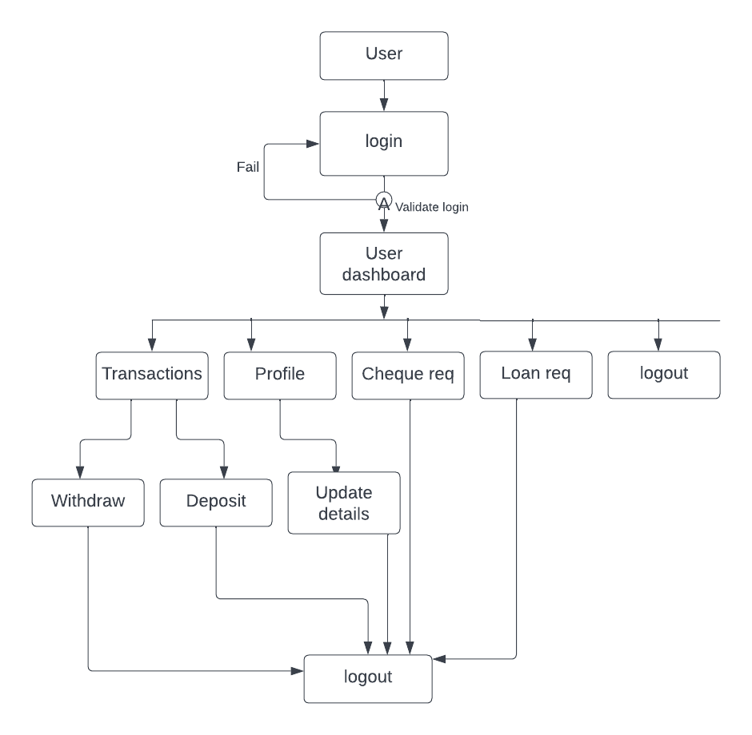
User Activity Diagram

Slide 9
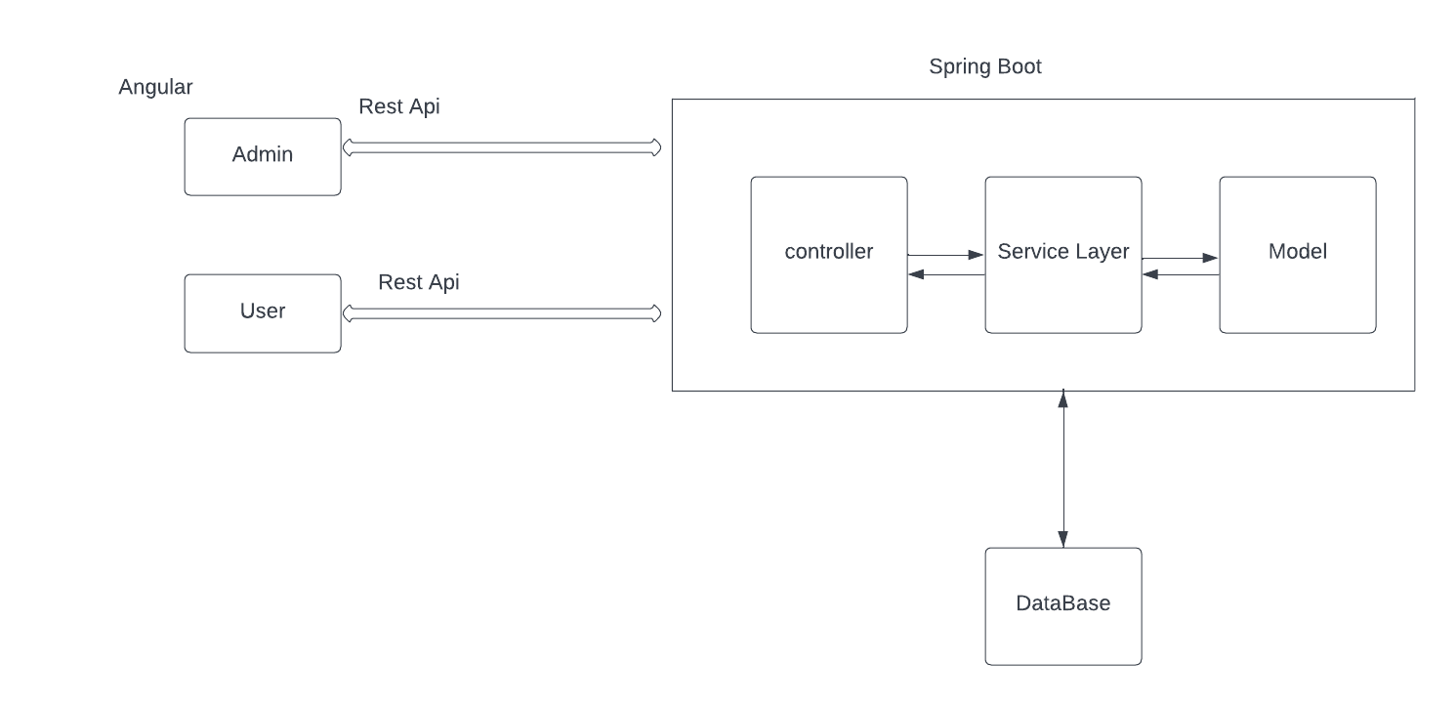
System Architecture

Slide 10
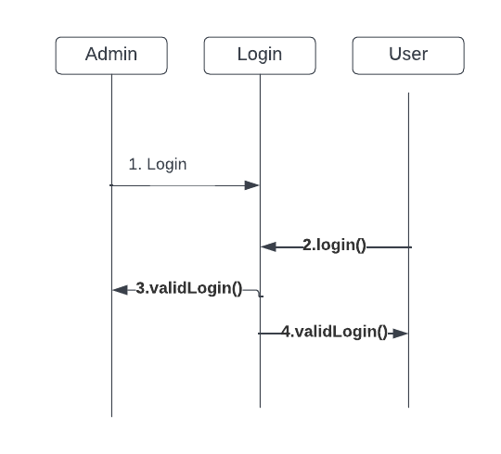
Login Sequence Diagram

Slide 11
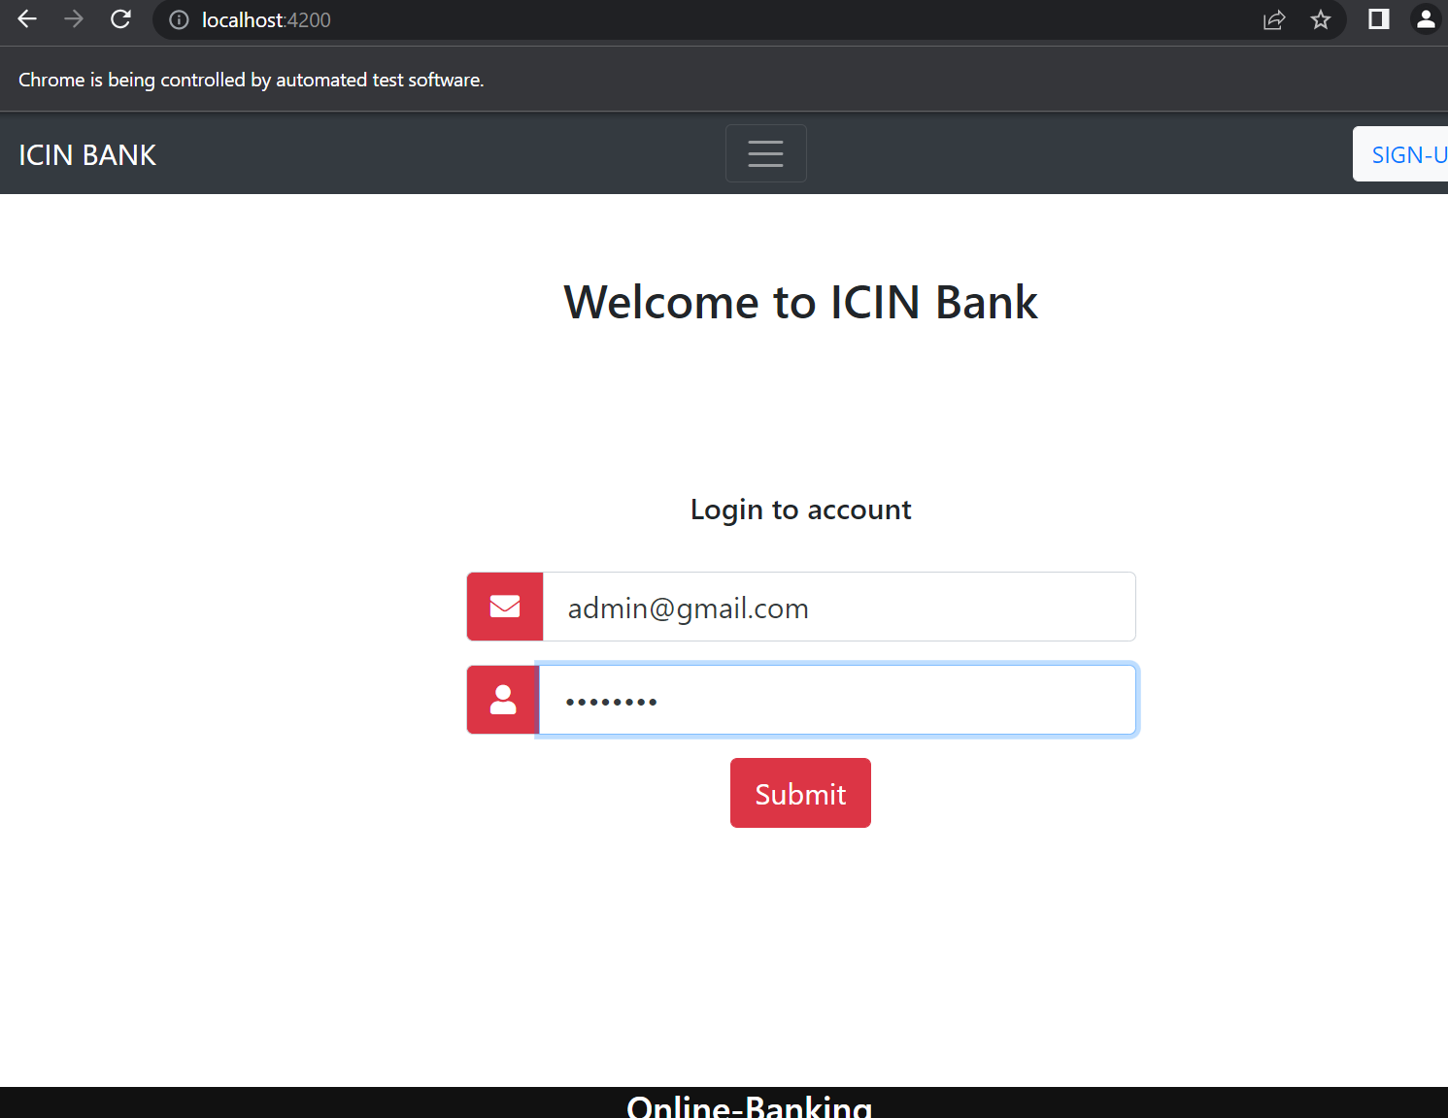

Slide 12
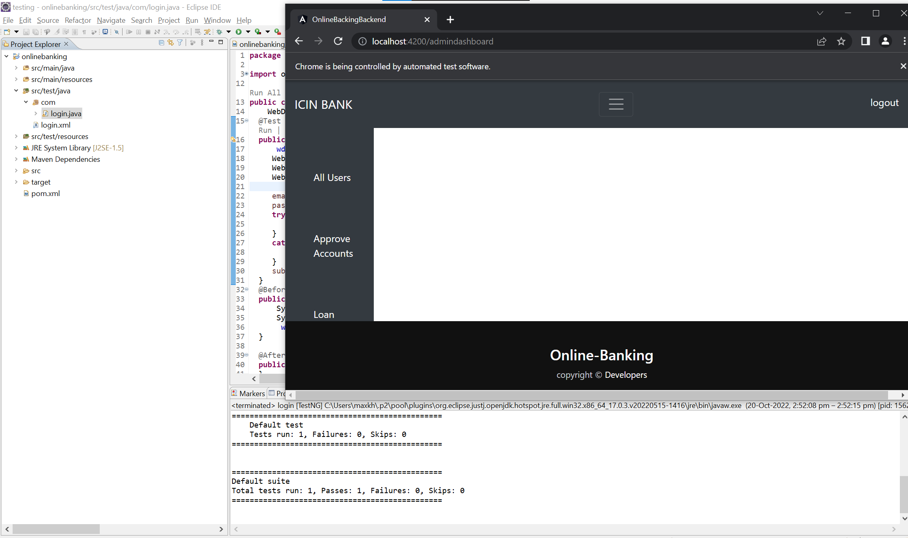

Slide 13
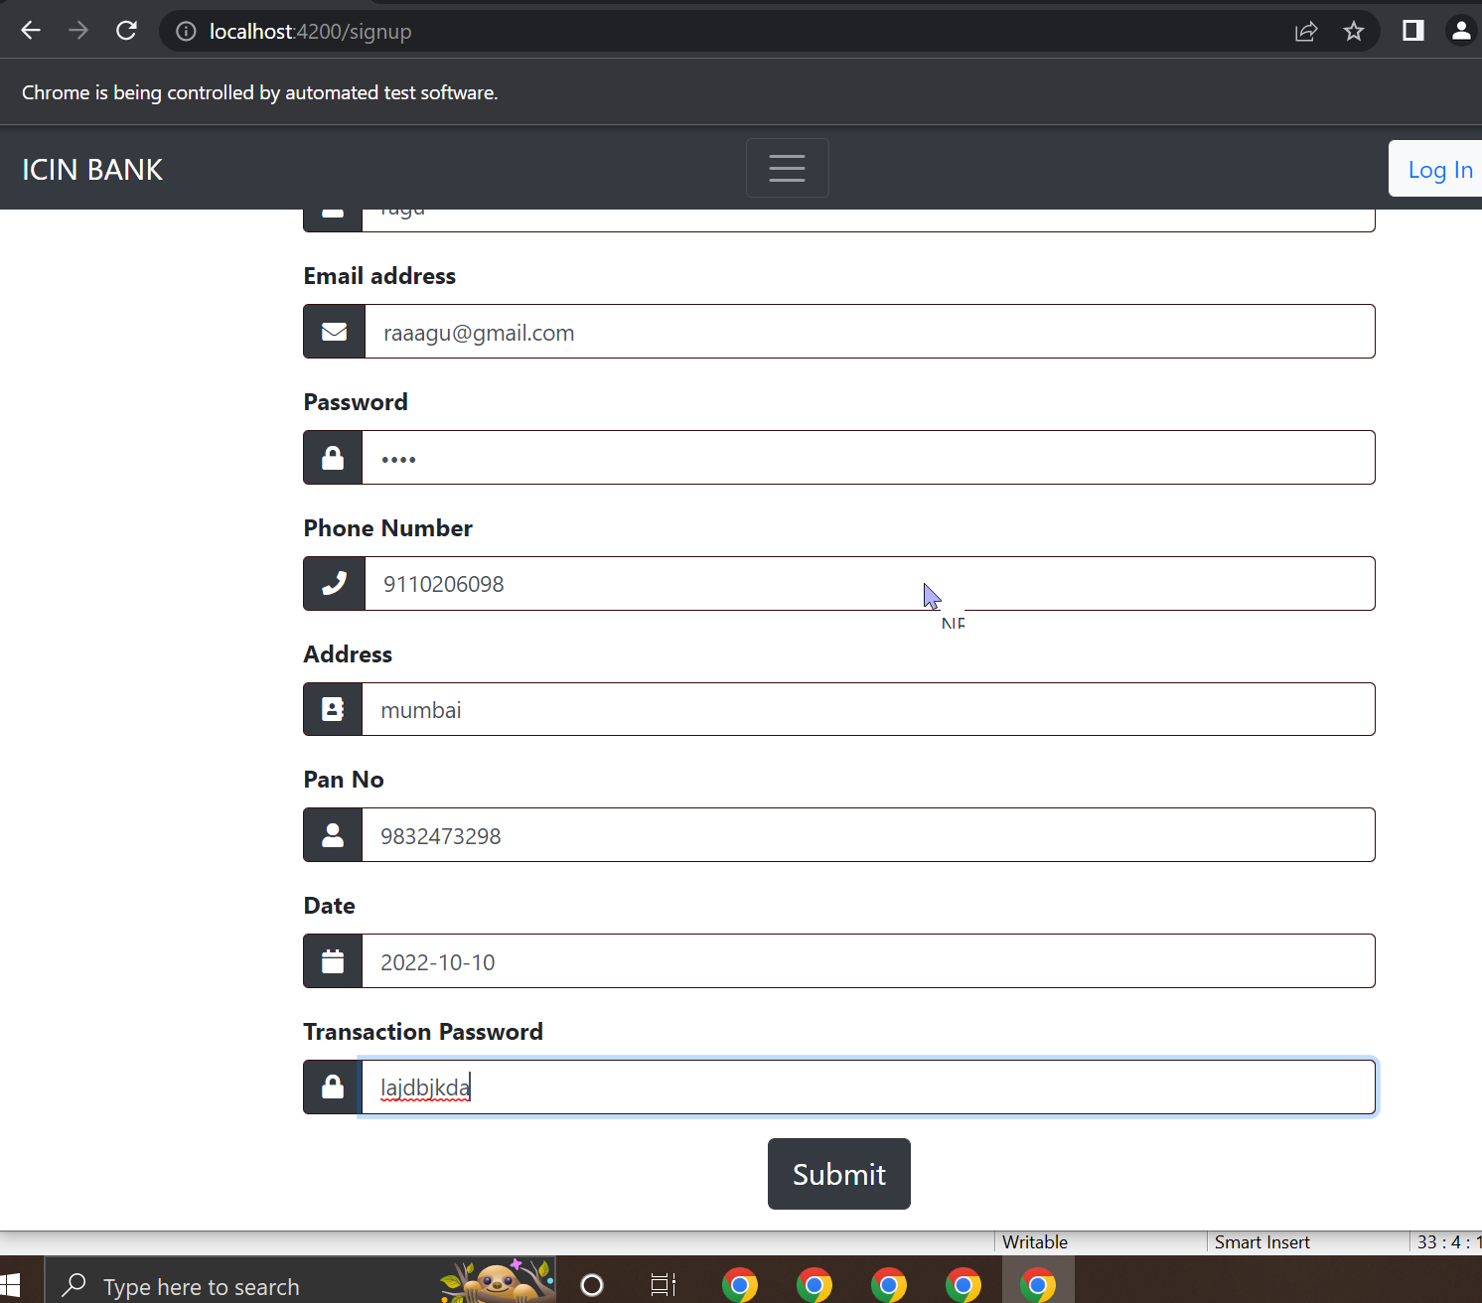

Slide 14
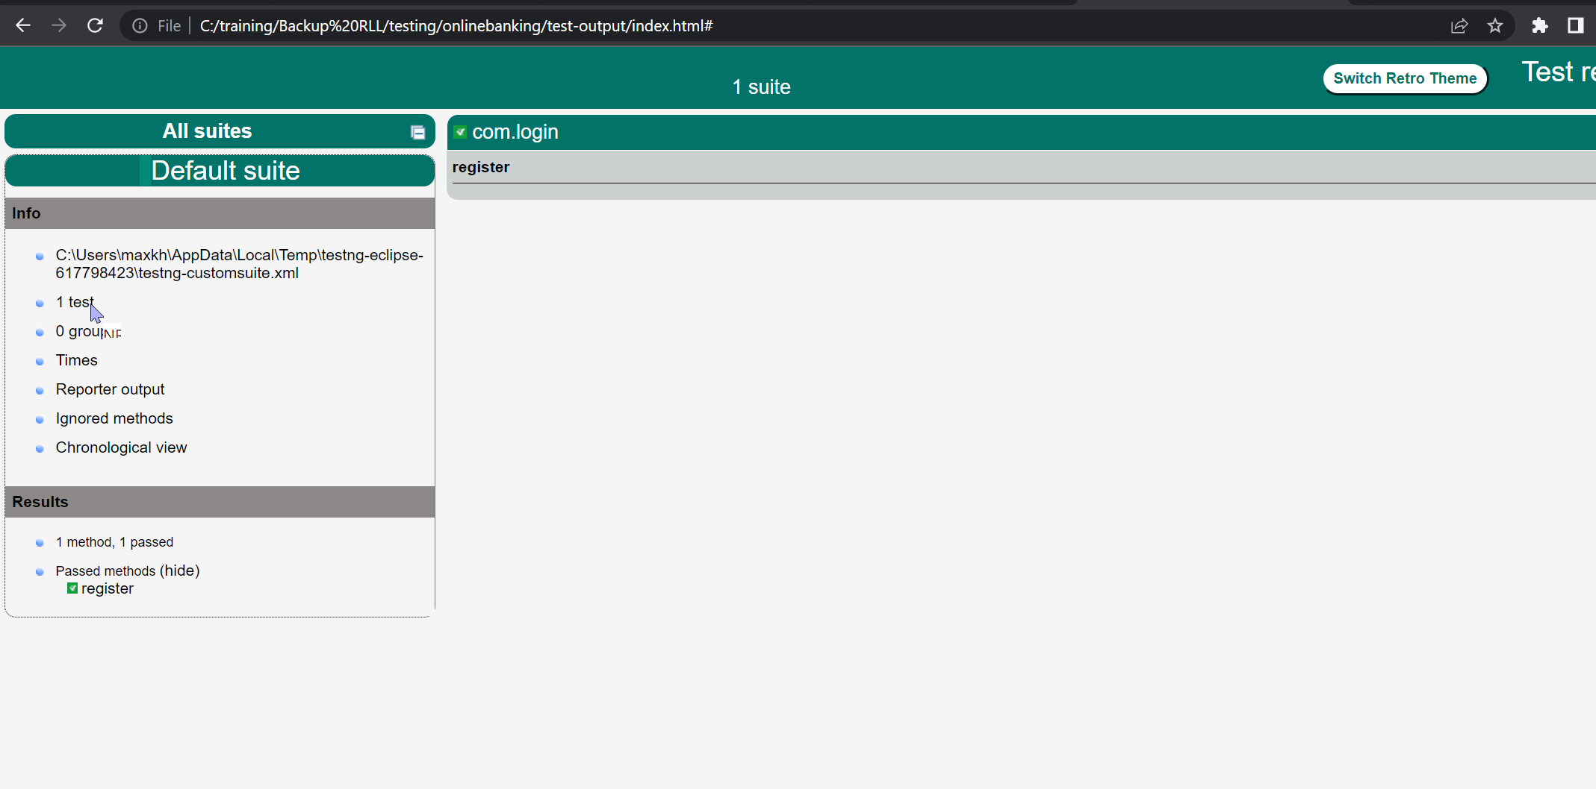

Slide 15
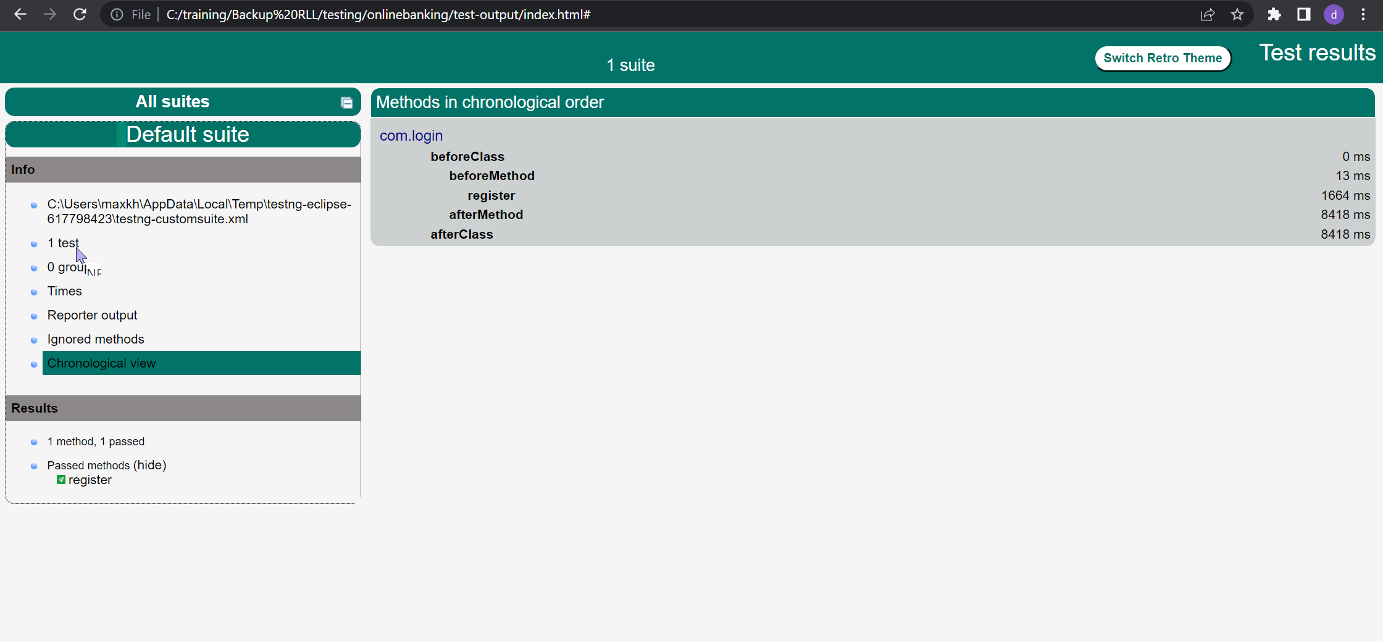

Slide 16
Admin action 1.Login to portal. 2. Admin can grant access accounts to get opened. 3.Grant access to the users regarding money transfer, deposits , and withdrawal. 4.Block a user account in case of any threat and authorize cheque book requests. 5. Open an account. 6.Handel new loans requests and also view the list of all approved and rejected loan request. 7.View the funds transferred. 8. Check the balance.

Slide 17
User actions: 1.Create account 2.Login to account. 3.User can change the password , address , email, and phone no. 4.User can deposit and withdraw money from the account. 5. User can view the balance in their primary and savings account. 6. User can request for cheque book for different accounts. 7. User can apply for loan.

Slide 18
Tools and Technologies:
Front-End : Angular 14
Server-side :Spring Boot , JPA
Back-end :MYSQL, Hibernate
Web Server : Tomcat

Slide 19
DATA BASE
Database: onlinebanking
Tables: account
accountloan
admin
loan
transaction
user
userregister

Slide 20
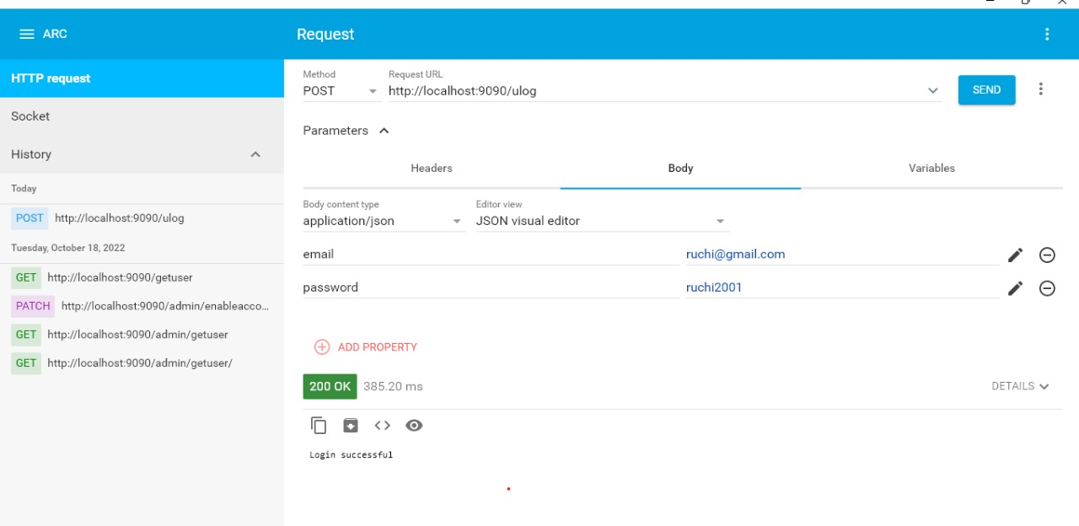

Slide 21
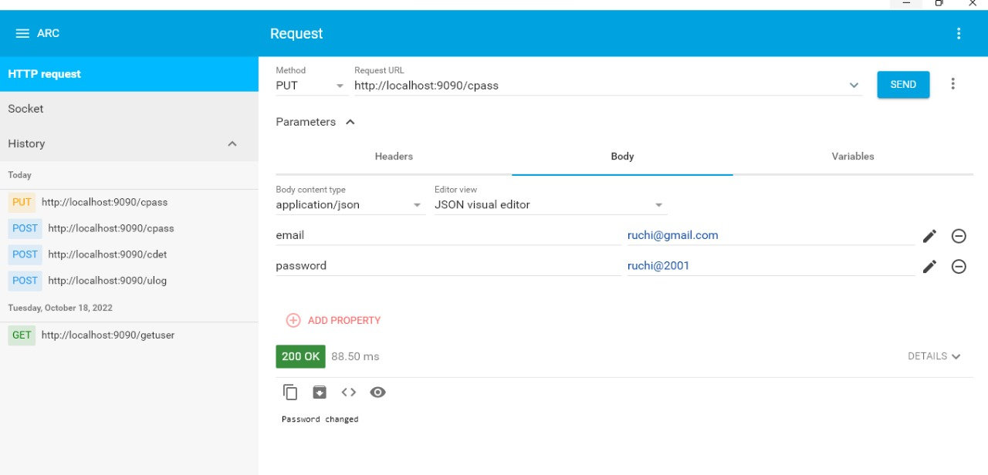
TESTING

Slide 22
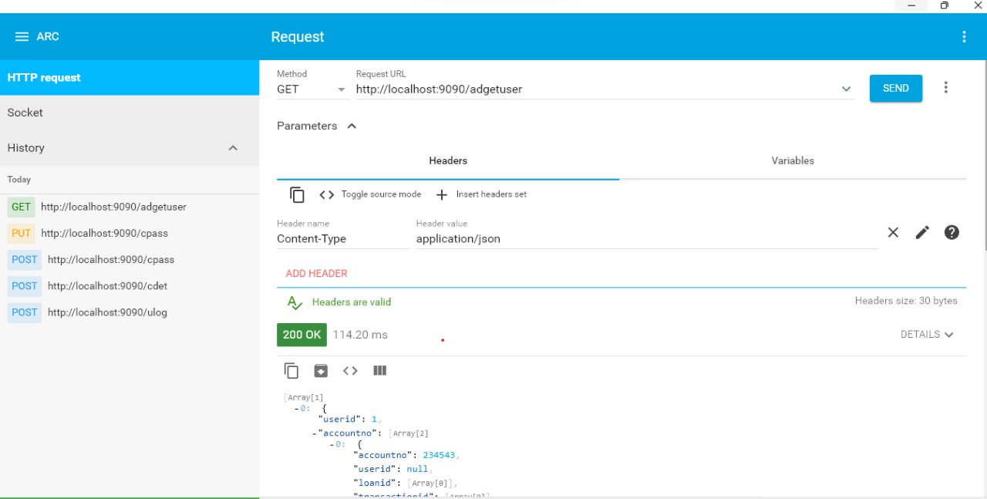

Slide 23
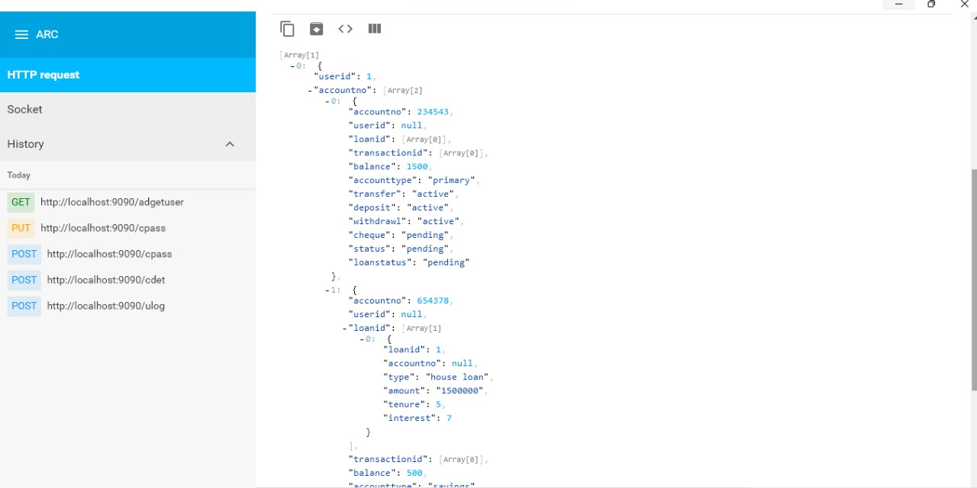

Slide 24
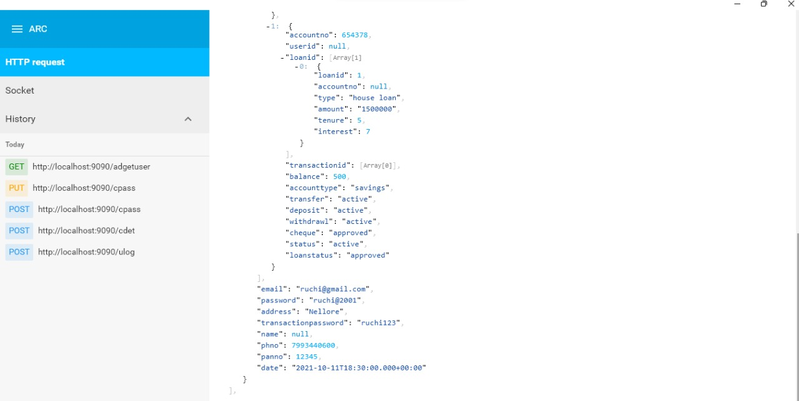

Slide 25
CONCLUSION
The creation of online banking is done successfully and is tested for the accurate results. During the completion of this project all the requirements for the project are accomplished and it meets the organisation needs.

